Slide 1

Image Sharpening Using Knowledge Distillation
INTERNSHIP 2
INDLA ABHISHEK
BU22CSEN0101761
Dept of Computer Science & Engineering

Slide 2
Abstract
This project builds a lightweight image sharpening system using knowledge distillation. A large model called SwinIR (Teacher) trains a smaller CNN model (Student) to sharpen blurred images. It achieves clear results with a Structural Similarity Index (SSIM) above 0.9. The system is built using PyTorch, to make it suitable for mobile apps or low-power devices.
Dept of Computer Science & Engineering

Slide 3
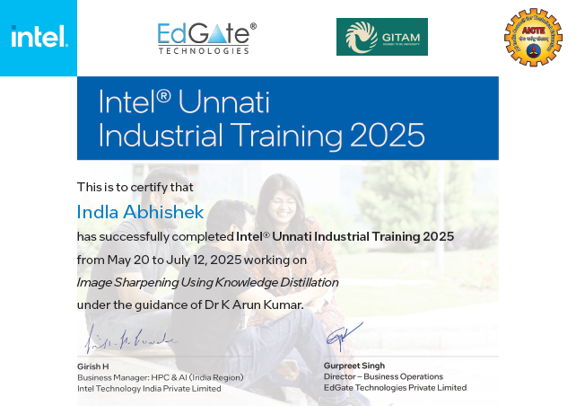
Certificate
Dept of Computer Science & Engineering

Slide 4
CONTENTS
Introduction
Objectives
Dataset
Model Architecture Overview
Knowledge Distillation Process
Results
Conclusion
Dept of Computer Science & Engineering

Slide 5
Introduction
High-quality images are vital in fields like photography, medical imaging, and
Editing process. However, images often lose clarity due to compression, low
resolution, or noise. This project uses knowledge distillation to improve image
sharpness, where a large teacher model trains a smaller, faster student model to
enhance blurred images efficiently.
Dept of Computer Science & Engineering

Slide 6
Objective
Develop a lightweight image sharpening model that enhances blurred images efficiently.
Use knowledge distillation to transfer learning from a large teacher model (SwinIR) to a smaller CNN model.
Achieve a Structural Similarity Index (SSIM) score above 0.9 for high image quality.
Dept of Computer Science & Engineering

Slide 7
Model Architecture Overview
The project uses two models — a teacher (SwinIR) and a student (lightweight CNN). Both models are based on the Convolutional Neural Network (CNN) algorithm.
About CNN:
CNNs are deep learning models specially designed to work with images.
They detect and learn features like edges, textures, and patterns using filters.
CNNs are widely used in image processing tasks like sharpening, and to improve resolution.
In this project, CNN helps the model analyze blurred images and reconstruct sharp, detailed versions efficiently.
Dept of Computer Science & Engineering

Slide 8
Knowledge Distillation Process
Teacher Model (SwinIR): A large and powerful image restoration model with deep layers and strong learning ability.
Student Model (Lightweight CNN): A smaller, faster version trained to mimic the teacher’s performance.
How they work:
The teacher model sharpens blurred images and produces high-quality outputs.
The student model learns from both the original image and the teacher’s results.
This process is called Knowledge Distillation, where the teacher transfers its knowledge to the student.
The final student model achieves high-quality sharpening with less computation and real-time performance.
Dept of Computer Science & Engineering

Slide 9
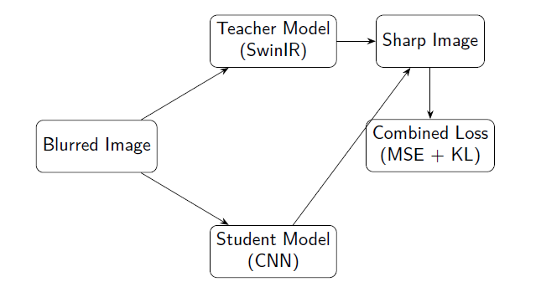
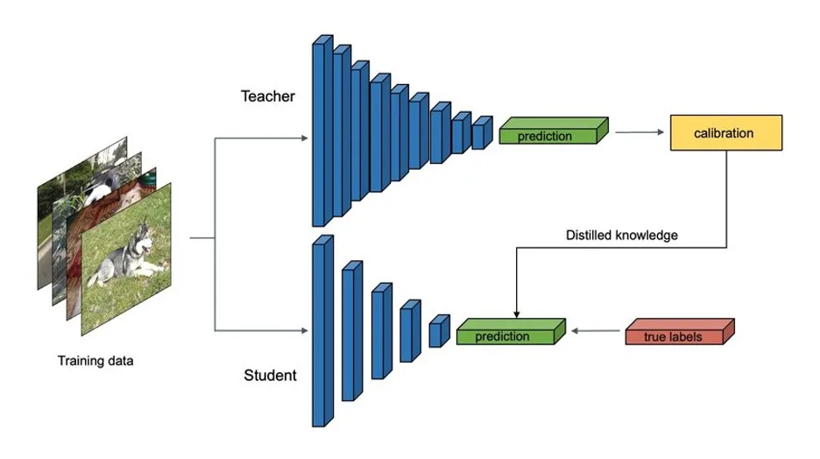
Knowledge Distillation Process
Dept of Computer Science & Engineering

Slide 10
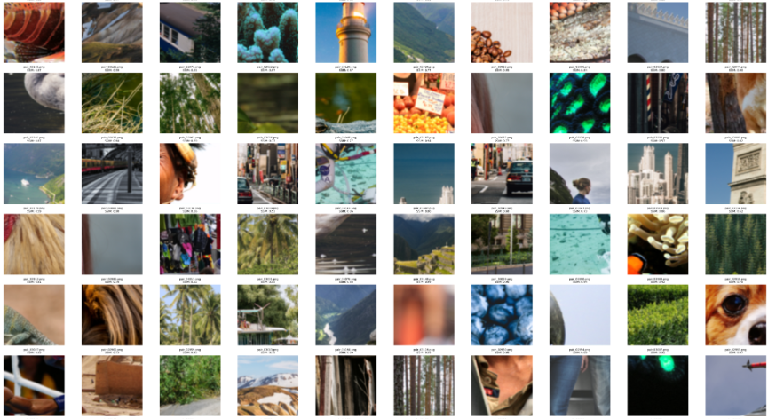
About DataSet
The project uses the DIV2K dataset with 800 high-resolution images.
Dept of Computer Science & Engineering

Slide 11
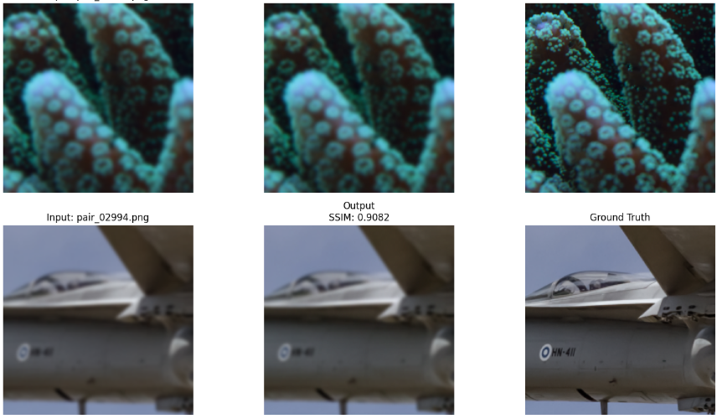
Dept of Computer Science & Engineering

Slide 12
Conclusion
The project successfully built a lightweight image sharpening model using knowledge distillation.
The teacher model guided the student model to achieve high-quality results with much lower computation.
It performs well on different types of images such as text, nature, and faces, producing clear and sharp outputs.
Overall, this system provides a fast, accurate, and efficient solution for photo editing, and mobile applications etc…
Dept of Computer Science & Engineering

Slide 13
References
Zhang, Kai, et al. "SwinIR: Image Restoration Using Swin Transformer." arXiv:2018.10257, 2021.
Hinton, Geoffrey, et al. "Distilling the Knowledge in a Neural Network." arXiv:2018.102531, 2015
Wang, Zhou, et al. "Image Quality Assessment: From Error Visibility to Structural Similarity." IEEE Transactions on Image Processing, vol. 13, no. 4, 2004.
Paszke, Adam, et al. "PyTorch: An Imperative Style, High-Performance Deep Learning Library." NeurIPS, 2019.
DIV2K Dataset: https://data.vision.ee.ethz.ch/cvl/DIV2K/
Dept of Computer Science & Engineering

Slide 14
Thank You
Dept of Computer Science & Engineering

